Slide 1
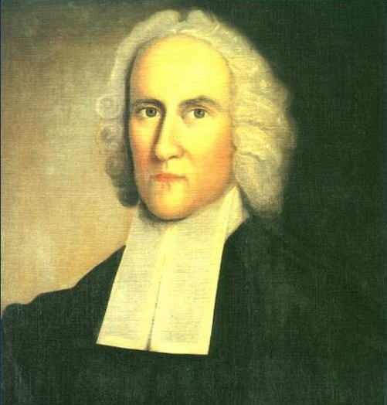
Jonathan Edwards Sinners in the Hands of an Angry God
Historical Objective
Relate Puritan beliefs to nature of work.
Identify role of individual in 1700’s
Literature Objective
Persuasive Writing
Figurative language
Mood

Slide 2
Journal Topic
The Power of Love or The Power of Hate
30 seconds to convince the audience on the power of love or the power of hate.
What did we notice when it was read using a “level” voice?
What did we notice when it was read with voice inflection and passion?
How does voice inflection play into convincing people of your point of view?
How does emotion play into convincing people of your view?

Slide 3
What is Jonathan Edwards trying to do?
Think back to your convincing argument on the power of love and the power of hate. How did you go about convincing your audience on a certain topic?
What skills are involved when you want to orally persuade effectively?
What is Edwards attempting to persuade Puritans to do? How do you know this?
Tone/voice inflection/word choice/message

Slide 4
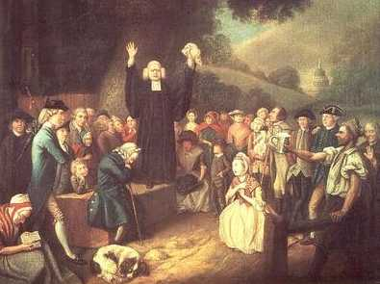
Understanding Sermons
What is a sermon?
Speech
Persuasive
Appeal to emotion
Uses archetypes (images, characters from classic literature, myths, or religious texts)
Uses figurative language to convey message

Slide 5
How do visual artists persuade?
What skills are necessary to persuade visually?
Tone, color, selection of images, placement of images, word choice, figurative language
Now its your turn to persuade movie goers to see a Jonathan Edwards themed film!

Slide 6
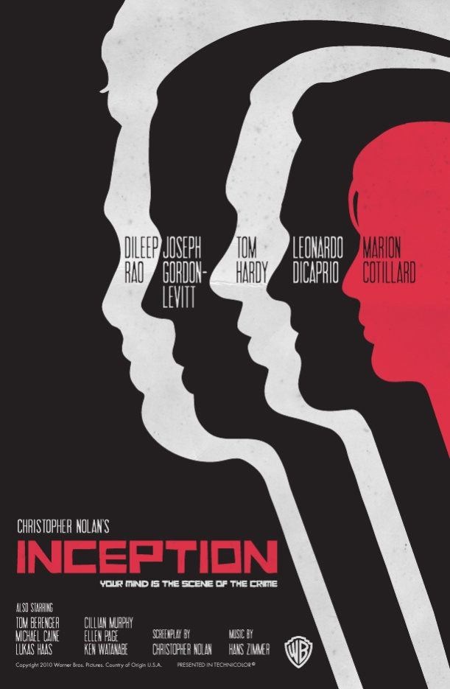
How does each poster visually persuade us to be interested in the film?

